Slide 1
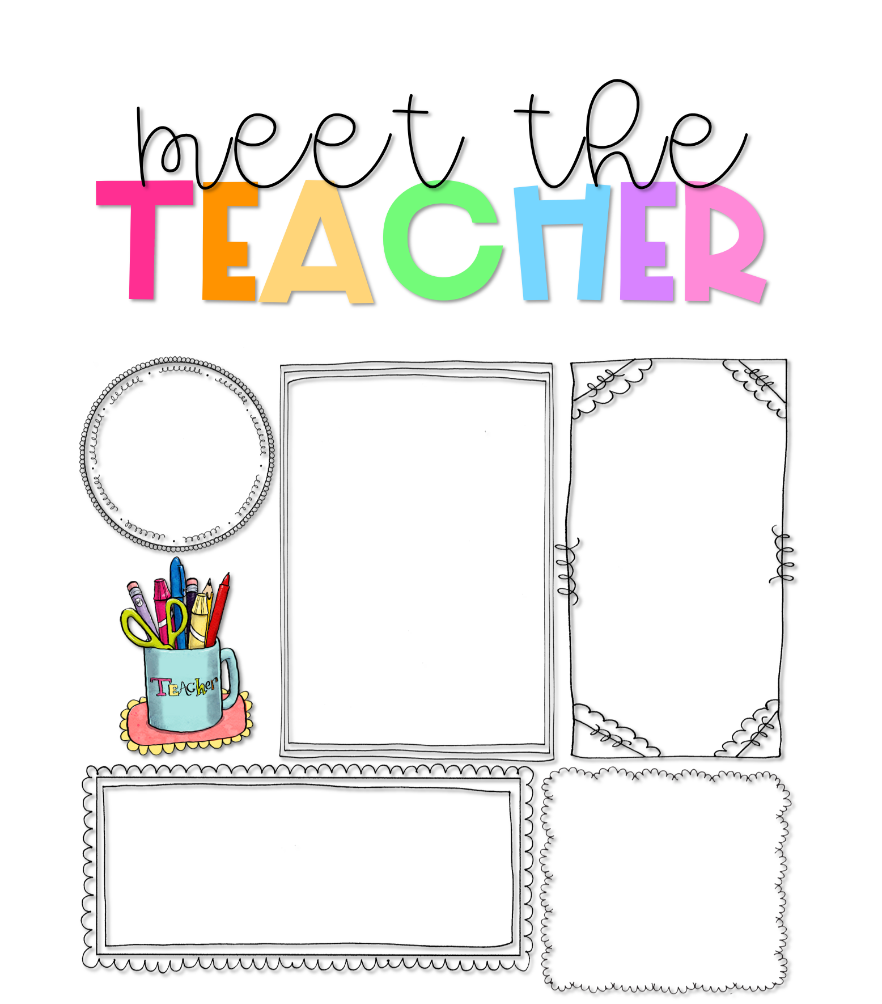
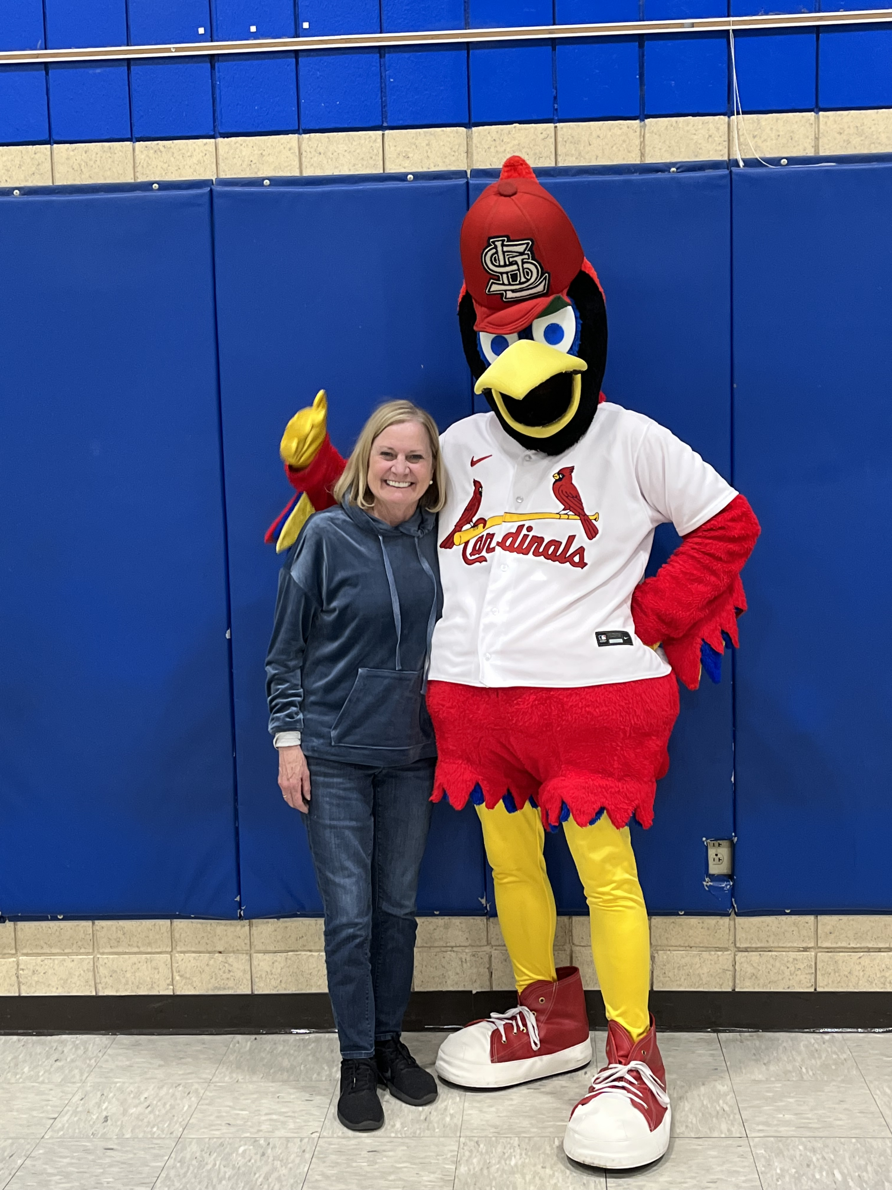
Mrs. Lisa Kadlec
About Me
Welcome to Kindergarten!
Hello! I’m Lisa Kadlec I have been at BWCJA for 17 years. I previously taught first and second at BWCJA.
I attended Mizzou for my teaching certification , then Maryville and Lindenwood to receive my Masters in Gifted Education. I taught for many years in the private sector. I have a 31 year old son who is married to a teacher! So we always have lots to talk about!
I grew up in St. Louis and I live in Affton. In June I became “Grammie” to sweet Eleanor!
I am excited to welcome you to the 2023-2024 school year at Betty Wheeler CJA! I’m looking forward to having your child as a student in Kindergarten which is such a fun year with so many wonderful learning activities to celebrate. In order to have a fun year, my most important goal is to create a family of learners in my classroom. I am committed to creating a classroom environment where your child is a valued, trusted, and integral part of our family of learners. In order to accomplish this, It is my hope that you will support and encourage this vision at home.
Contact Me
Email with any questions or concerns!
I like salty almonds, tacos, and chocolate.
I like everything!
314-353-8875
!
lisa.kadlec@slps.org

